Slide 1

Project Presentation on Manufacturing plant network
Amal Antony Alex - FET-BCD-2023-27-020
Swosti Sanhita Jena - FET-BCD-2023-27-022
Chidananda Sashank Bhuyan - FET-BCD-2023-27-025
Chiranjibi Dash - FET-BCD-2023-27-026
Dr. Chinmaya Kumar Nayak - Internal Mentor
Ms. Neha Bagle - External Mentor
Faculty of Engineering & Technology, Sri Sri University, Cuttack.

Slide 2
Contents:
Abstract
Introduction
Literature Review
Objective
Motivation
Problem Statement
Proposed Solution
System Design
Technical Details
Implementation
Testing & Results
Conclusion
References

Slide 3
Abstract
This project details the design and implementation of a scalable and secure network infrastructure for a modern manufacturing plant. The infrastructure design is a hierarchical network design with Core, Distribution, and Access layers for high availability and performance. The zone Integration covers Production, Engineering, Corporate, Storage, DMZ, and Guest zones. Traffic Segmentation is done through VLANs which isolate IoT devices, SCADA systems, and enterprise networks. Security Measures includes firewalls, intrusion prevention, port security, and ACLs to protect against industrial cyber threats targeting OT systems. The goal of this project is to ensure a resilient, secure, and efficient network for seamless communication and data flow.

Slide 4
Introduction
Designing a scalable network design and implementation for a manufacturing plant by integrating diverse units (Assembly, QC, Logistics, Admin) with secure communication and real-time monitoring. Ensuring seamless operations, protects against cyber threats, and supports future growth. Also addressing the critical need for robust and secure industrial networks in modern manufacturing. Using a hierarchical network model approach (Core, Distribution, Access Layers) ensures scalability and redundancy. Emphasizing on VLAN segmentation and OT security to protect industrial control systems.

Slide 5
Literature Survey/ Existing Work
S. No. | Author(s) | Year | Title | Objective | Methodology | Key Findings | Gaps Identified
1 | G. Mwansa | 2024 | Enhancing Practical Skills in Computer Networking: Evaluating the Unique Impact of Simulation Tools, Particularly in Cisco Packet Tracer. | This study examines the effectiveness of networking simulation tools, particularly Cisco Packet Tracer, in enhancing the learning experiences | The CIPP Evaluation Model | Simulation tools significantly improve students’ practical skills understanding of theoretical concepts in computer networking | Longitudinal studies, mixed methods, and comparative studies
2 | Das et al. | 2023 | Packet tracer for smart home networks and real-world monitoring | To demonstrate how to run IoT-based technologies using Cisco Packet Tracer, connecting IoT devices to a home portal gateway for smart home network control | Using Cisco Packet Tracer software to connect and control IoT devices in a smart home network, including solar panels and batteries | Monitor IoT devices in a smart home setting, allowing users to check device functionality | The study does not address the limitations of using a simulated environment versus real-world conditions and the scalability of such systems

Slide 6
Literature Survey/ Existing Work
S. No. | Author(s) | Year | Title | Objective | Methodology | Key Findings | Gaps Identified
3 | Malanchini et al. | 2023 | Convergence of Manufacturing and Networking in Future Factories | To highlight the potential for intelligent networking and advanced ML -based solutions Industry’s | The work presents a vision and framework by introducing network-aware and production-aware principles | Manufacturing-network integration enables adaptable machines and dynamic communication networks. | Challenges include addressing issues in private networks and exploring future 6G
4 | Lindenschmitt et al | 2023 | 6G Underlayer Network Concepts for Ultra Reliable and Low Latency Communication in Manufacturing | To propose underlayer network designs tailored for manufacturing environments, ensuring low latency, high reliability, and robust security.. | The study introduces a network concept for underlayer networks and evaluates its application in closed-loop communication for machine tools. | Enhance flexibility and efficiency in manufacturing by integrating wireless technologies, addressing challenges like signal interference and latency. | Further research is needed to explore the practical implementation of underlayer networks in diverse manufacturing settings.

Slide 7
Literature Survey/ Existing Work
S. No. | Author(s) | Year | Title | Objective | Methodology | Key Findings | Gaps Identified
5 | J. Allison | 2022 | Simulation-Based Learning via Cisco Packet Tracer to Enhance the Teaching of Computer Networks | To enhance the teaching of computer networks through simulation-based learning using Cisco Packet Tracer | Implementation of simulation-based learning in cisco packet tracer | Simulation-based learning with Cisco Packet Tracer improves the teaching of computer networks | Comparative studies are needed to evaluate the effectiveness against traditional lab methods and other simulation tools.
6 | Cisco Networking Academy | 2020 | Switching, Routing, and Wireless Essentials Companion Guide (CCNAv7) | To provide a comprehensive companion guide that aligns with the Cisco Networking Academy’s CCNAv7 curriculum. | The book combines theory with hands-on exercises, case studies, and Packet Tracer activities. | Delivers foundational networking knowledge, including VLANs, STP, EtherChannel, IPv4 and IPv6 routing, and WLAN configurations | Lacks deeper exploration into emerging networking technologies like SDN (Software-Defined Networking) and cloud networking.

Slide 8
Literature Survey/ Existing Work
S. No. | Author(s) | Year | Title | Objective | Methodology | Key Findings | Gaps Identified
7 | J. F. Kurose & K. W. Ross | 2020 | Computer Networking: A Top-Down Approach (7th Edition) | Aims to provide a comprehensive understanding of computer networking, focusing on a top-down & lower-layer networking approach that starts with application-layer protocols | High-level networking concepts such as web applications, HTTP, and email protocols before introducing transport, network, and link-layer protocols. | A top-down approach enhances understanding by relating networking principles to real-world applications before diving into technical details. | Primarily focuses on traditional networking models and might not extensively cover the latest advancements in AI-driven networking and machine learning applications in networking.
8 | D. D. Coleman & D. A. Westcott | 2020 | CWNA Certified Wireless Network Administrator Official Study Guide (5th Edition) | To provide a comprehensive guide for wireless networking professionals preparing for the CWNA certification. | Technical explanations of Wi-Fi standards, RF behavior, wireless security, and enterprise WLAN architecture are provided. | Proper WLAN design and security implementation with in-depth coverage of 802.11 standards and best practices. | Lacks coverage of emerging technologies like Wi-Fi 6E and 5G integration in wireless networks.

Slide 9
Objective
Design a comprehensive network infrastructure for the manufacturing plant.
Implement VLAN segmentation for secure communication between different zones
Enable real-time network monitoring to quickly detect and resolve issues.
Ensure high availability and redundancy to minimize downtime.
Protect the Operational Technology (OT) systems from industrial cyber threats.

Slide 10
motivation
Modern manufacturing relies on interconnected systems for efficiency and productivity. Cybersecurity threats to industrial networks are increasing, demanding robust security measures. Scalability is crucial to accommodate future growth and technological advancements. This project offers hands-on experience in designing and implementing a real-world network solution. Opportunity to apply network security principles to protect OT systems from cyber threats.

Slide 11
Problem statement
Develop a scalable network for a manufacturing plant integrating Assembly, Quality Control, Logistics, and Administration.
Support seamless communication between production lines and inventory systems.
Implement VLAN segmentation for secure communication between IoT devices, SCADA systems, and enterprise networks.
Enable real-time monitoring to detect and respond to network issues without disrupting operations.
Ensure high availability and protection against industrial cyber threats targeting OT systems.

Slide 12
Proposed solution
The network will be structured using a hierarchical model with three distinct layers:
Core Layer Devices - 2 Core Routers connected to ISPs(Cloud).
Distribution Layer Devices - 3 Multilayer Switches.
Access Layer Devices - Dedicated Access Switches and Wireless Access Points (APs)
The entire network is divided into 6 Zones – The Guest & Reception Area(2), Production Zone(2), Engineering Zone(2), Corporate Zone(5), Storage Zone(3) and The DMZ(3).
Each department will operate on a separate VLAN & will implement DHCP for dynamic IP allocation, with static IPs reserved for servers
OSPF (Open Shortest Path First) & NAT Overload (PAT) Routing Protocols will be used.

Slide 13
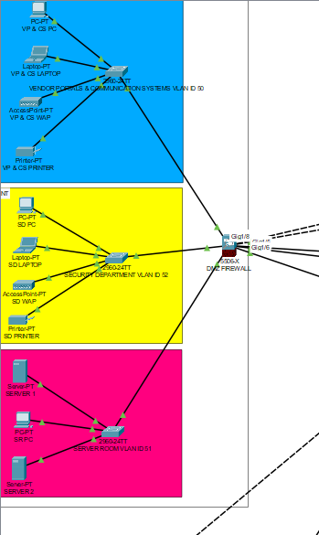
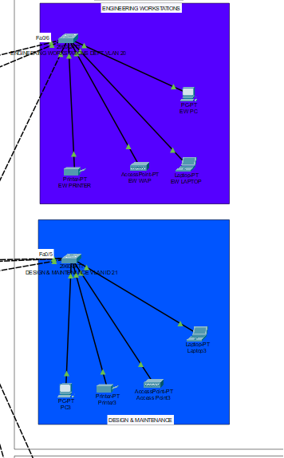
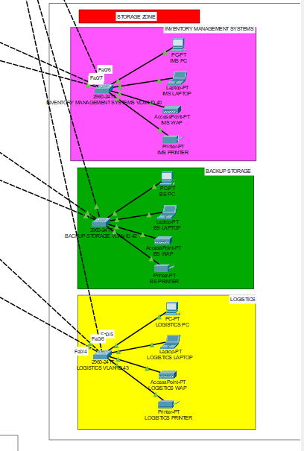
System Design:-
PART A - DMZ
PART B – Engineering Zone
PART C – Storage Zone

Slide 14
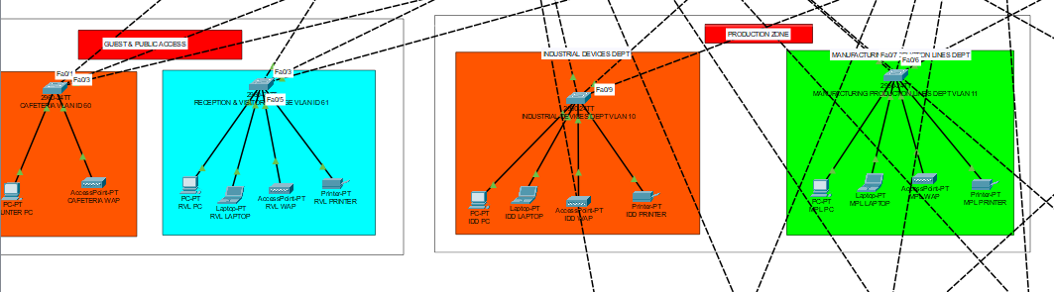
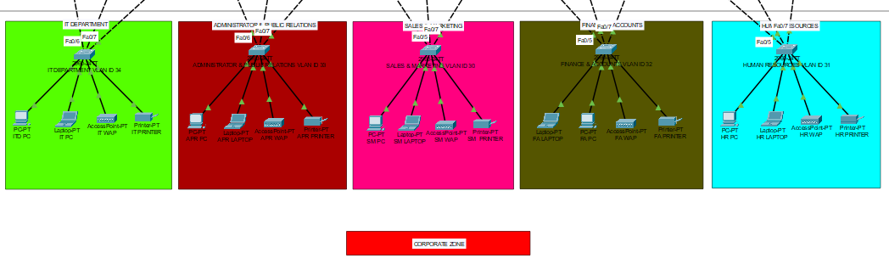
System Design:-
PART D – Guest Zone & Production Zone
PART E – Corporate Zone

Slide 15
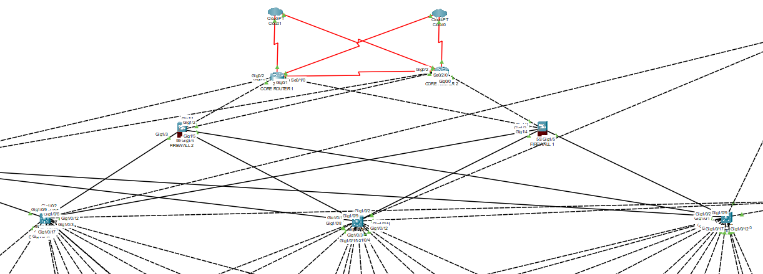
System Design:-
PART F – Core Layer & Distribution Layer

Slide 16
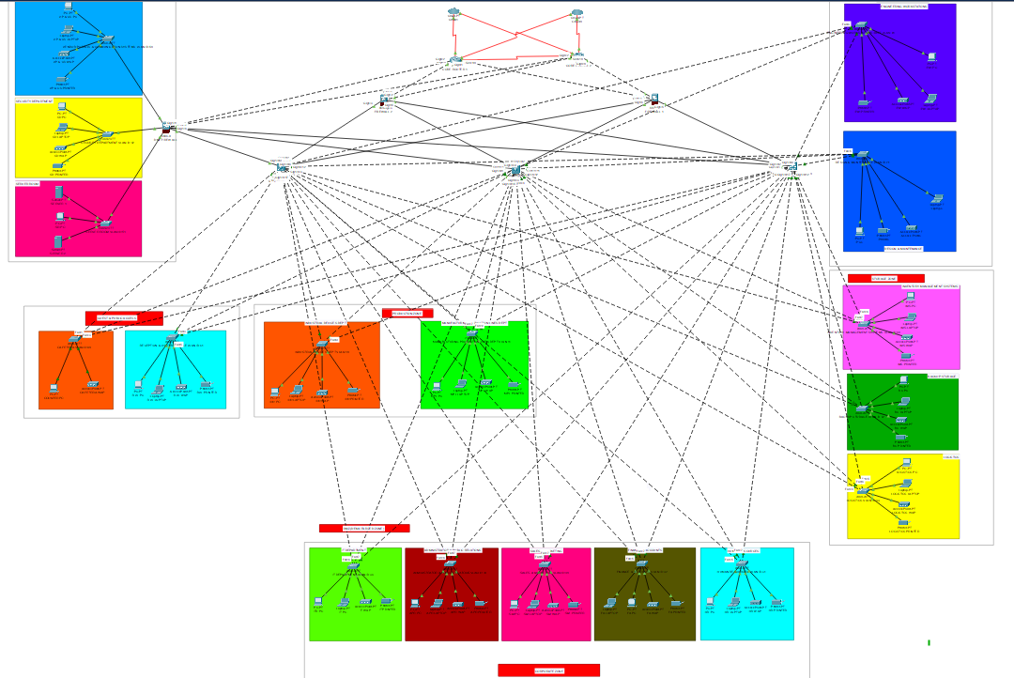
System Design:-

Slide 17
Technical Details:-
Hardware:-
2 Core Routers(Series-2911), 3 Multilayer Switches(Series-3650-24PS), 17 Access Switches(Series-2960-IOS15), 2 Servers(Series –Server-PT), 3 Firewalls(Series-5506-x), 17 PCs, 15 Printer & 17 UPS, 16 Wireless Access Points.
Software:-
Cisco Packet Tracer for simulation(v 8.2.2), DHCP Server for IP allocation, OSPF & NAT Overload for routing protocols.
IP address:- Base network - 172.16.0.0/16 IP Range - 172.16.0.0 – 172.16.240.47 Total subnets – 29
VLAN – 20 VLAN IDs are used for subnetting.
Notes:
1. Core Routers – Cisco 2911 Series
Why it's better:
It's part of the Cisco ISR G2 (Integrated Services Router Generation 2), which supports modular expansion, voice/video, and security features.
It supports routing protocols like OSPF, EIGRP, BGP, making it great for core/backbone routing.
Enough CPU/memory in simulation for large networks.
🔀 2. Multilayer Switches – Cisco 3650-24PS
Why it's better:
Layer 3 switching capability (can do inter-VLAN routing, static/dynamic routing).
Supports PoE (Power over Ethernet) for devices like IP phones and wireless access points.
Ideal for distribution layer, bridging the gap between access and core.
🧷 3. Access Switches – Cisco 2960 with IOS 15
Why it's better:
Standard for Layer 2 switching, perfect for access layer deployment.
IOS 15 version includes modern features like VLANs, port security, spanning tree protocols, EtherChannel, etc.
Light on resources; good performance even with many devices connected.
💾 4. Servers – Server-PT (Generic)
Why it's better:
Highly customizable: can run services like HTTP, FTP, DHCP, DNS, Email, etc.
Simple interface but enough features to simulate real-world server behavior in a learning environment.
🔥 5. Firewalls – Cisco ASA 5506-X
Why it's better:
Mimics real Cisco Adaptive Security Appliance (ASA) firewalls.
Can apply security policies, NAT, ACLs, and zone-based firewall configs.
Offers good perimeter security for edge/border networks in simulations.
💡 In Summary:
You're using a hierarchical network design with:
2911 routers for powerful, modular routing at the core.
3650 switches for smart Layer 3 switching at the distribution layer.
2960s for reliable Layer 2 switching at the access layer.
Firewall and servers for realistic edge protection and network services.
This combo reflects a well-struc

Slide 18
Implementation:-
There are 6 zones which are divided into departments with following VLAN IDs -
Industrial Devices(60), Manufacturing Production Lines(11), Engineering Workstations(20), Design & Maintenance (21), Sales & Marketing (30), Human Resources(31), Finance & Accounts(32), Administrator & PR(33), IT Dept(34), Inventory Management(40), Backup Storage(42), Logistics(43), Vendor Portals(50), Server Room(51), Cafeteria(10), Reception(61).
We have done VLAN segmentation for secure communication between IoT devices.
We have used 172.16.0.0/16 as the base network for subnetting.
We have enabled Port Security using sticky MAC method.
We have deployed a dedicated firewall in the Server Room in the DMZ to monitor incoming and outgoing traffic.
We have configured ssh on all routers and multilayer switches and we are using ACL to restrict access to sensitive resources.
We have used OSPF as the routing protocol for internal routing and NAT Overload (PAT) on the core routers.

Slide 19
Testing & Results:-
The network underwent a series of test cases to ensure functionality and adherence to design objectives. Inter-VLAN communication was successful where permitted, confirming proper routing and ACL configurations. Internet access was achieved through core routers using NAT, and DHCP services effectively assigned dynamic IPs across all VLANs. VLAN security was validated through successful traffic isolation between departments. Redundancy mechanisms, including HSRP, ensured uninterrupted connectivity during router failover scenarios. Wireless connectivity via department-specific SSIDs provided secure access, while Guest WiFi remained isolated. SSH access allowed secure remote management of network devices. Finally, port security and logging mechanisms successfully detected and blocked unauthorized devices, with corresponding alerts generated, confirming the effectiveness of network monitoring tools.

Slide 20
Conclusion
This project provides a practical solution for designing a secure and scalable network for a manufacturing plant. The implementation of VLANs, routing protocols, and security measures enhances network performance and protects critical systems. Real-time monitoring ensures proactive issue resolution and minimizes downtime. The project contributes to a more resilient and efficient manufacturing environment. The network design is future-proofed to support growth and technological advancements.

Slide 21
references
Mwansa, G., Ngandu, M. R., & Dasi, Z. S. (2024). Enhancing Practical Skills in Computer Networking: Evaluating the Unique Impact of Simulation Tools, Particularly Cisco Packet Tracer, in Resource-Constrained Higher Education Settings. Education Sciences, 14(10), 1099.
Das, B. J., Chidambaram, V., & Palanidoss, S. (2023, November). Packet tracer for smart home networks and real-world monitoring. In AIP Conference Proceedings (Vol. 2946, No. 1). AIP Publishing.
Malanchini, I., Michailow, N., Agostini, P., Ali-Tolppa, J., Hock, D., Kasparick, M., ... & Zhou, Q. (2023). Convergence of Manufacturing and Networking in Future Factories. arXiv preprint arXiv:2312.08708.
Lindenschmitt, D., Mertes, J., Schellenberger, C., Schmitz, M., Han, B., Aurich, J. C., & Schotten, H. D. (2023, October). 6G Underlayer Network Concepts for Ultra Reliable and Low Latency Communication in Manufacturing. In European Wireless 2023; 28th European Wireless Conference (pp. 26-30). VDE.

Slide 22
references
4. Allison, J. (2022, July). Simulation-based learning via cisco packet tracer to enhance the teaching of computer networks. In Proceedings of the 27th ACM Conference on on Innovation and Technology in Computer Science Education Vol. 1 (pp. 68-74).
5. Cisco Networking Cisco Networking Academy. (2020). Switching, Routing, and Wireless Essentials Companion Guide (CCNAv7). Pearson Education, Limited.
6. Kurose, J. F., & Ross, K. W. (2007). Computer networking: A top-down approach edition. Addision Wesley.
7. Coleman, D. D., & Westcott, D. A. (2014). CWNA: Certified wireless network administrator official study guide: Exam CWNA-106. John Wiley & Sons.

Slide 23
Thank you

